Slide 1
Thesis/ Project Writing
Presentation By
Seema Verma

Slide 2
Project/Thesis
A Project or Thesis involves research carried out by an individual or a team.
It is a planned activity that spans over a short or long period of time.
For instance, a student may take two years to complete a research project on setting up a biogas plant on her university campus while she may take five years to complete her thesis on a topic.

Slide 3
Importance of Research Analysis and Findings
To inform others about the research
To record the research process and results
To provide a detailed insight into the various concepts and steps involved .
To publish the report to get approval from experts
To ensure that the research is not reproduced
To enable the readers to pursue further research

Slide 4
Though the project report or a thesis may vary in length, the style of writing involved is the same—factual, precise, concise, clear, well-structured, free from grammatical and syntactical errors and supported by appropriate illustrations. Hence, the project report and thesis strictly adheres to the elements of effective technical writing.

Slide 5
Steps Involved/ Structural elements of Project
Problem / Need for the project/ Background
Literature Review
Description of the project
Summary, Conclusions and Recommendations
References

Slide 6
Problem / Need
Introduction, Statement of the problem, Purpose & Scope, Limitations, Concept/ definition, Significance
Introduction This section provides a general introduction to the project topic. It throws light on the answers to the following questions:
What is the need for this project or why is this project important?
What is the problem involved?
What are the objectives?
What is the scope and what are the limitations?
What concepts and definitions does the topic area involve?

Slide 7
Statement of the problem
Here you need to be very specific to the problem. Focus on the significance of the problem or how it impacts the environment. For instance, if you are taking up a project on setting up solar water systems for various hostels in your campus, the problem would be—the difficulties faced on campus with frequent power cuts, the increasing electricity charges, maintenance of geysers, etc. All problems need to be described in detail. If your pursue a project on some research topic, you need to explain the problems that the existing research are posing and the need for looking into the topic from a different angle.

Slide 8
Purpose, Scope and Limitations
Very important part of your report, this topic requires your clear and sound thinking to arrive at the project objectives. You can write down questions or statements to tell the readers what your project aims at. Keep in mind the following:
Emanate from your reading of previous works on the topic in hand
Clarify the problem statement stated in the previous section
Are clear and unambiguous
Are specific and not repeated
Are verifiable
Are completely relevant to the topic without any deviation

Slide 9
Concept definition Most of the academic research projects involve various terms and concepts. Analyze and define each one of them in simple terms. A project on biogas plant installation may involve concepts and terms such as renewable energy, sustainable investment, anaerobic digester, landfill gas, etc. Definitions enable the readers understand the project in its true perspective.
Significance Every project should have some value and should be useful to the society, industry or academia. The introductory section of your project ends by stating the significance, value or usefulness of your project—how it is going to help your organization or how it can enrich the knowledge on a particular topic.

Slide 10
Literature Review
The term Literature Review refers to the process of reading, analyzing, evaluating and summarizing scholarly materials pertinent to the project topic. In other words, it is an account of what has been published on the topic by reputed scholars and researchers. It is the first step in your project research and helps you formulate your research questions which eventually turn into your project objectives. Answer the following questions while conducting literature review
What—exact views of the author on the topic
Why—reasons for the views or opinions
Where—context in which the views are expressed

Slide 11
For instance, when you are taking up a project on setting up a biogas plant on your campus, you need to go through the books, journals, newspaper articles, reports, etc., to understand what concepts are involved, why the system is beneficial, what are the difficulties involved, etc., so that you can come up with some remedies through your project thus helping future researchers

Slide 12
Description of the project
Describing the project details, include Design, Target population, Project evaluation and Timeline. Design refers to the plan and its specifications. For example, the design for a project on Biogas system installation would give a detailed explanation of the steps involved with detailed illustrations—flowcharts, diagram, pictures, etc.
In fact, the design serves as a roadmap for the readers to understand the various steps, equipment, process, end product, etc., clearly. If necessary, you can also include the relevant detailed documents in the Appendix part of your report

Slide 13
Discuss how your project would benefit your target audience. In case of biogas installation, for instance, you need to discuss how your campus residents would get benefitted and how the environment would become more hygienic with the recycling of waste. Justify that your project is effective and efficient by comparing your product with the other popular products. Also include the timeline or time taken to complete your product.

Slide 14
Summary, Conclusions and Recommendations
The summary section gives an overall view of the entire process and procedures you had discussed. You need to draw inferences from your project evaluation and present them logically as conclusions. Use the recommendations section to give some suggestions to modify or improve upon the product/ system.

Slide 15
References
All research-based writing such as project writing, dissertation and thesis writing include a References section which informs the readers the sources you have consulted and used in your research. Sources, as you are aware may be books, journals, newspaper articles, government reports, web sources, etc.

Slide 16
Thesis Writing
Thesis is a long research report. The report concerns a problem or series of problems in your area of research and it should describe what was known about it previously, what you did towards solving it, what you think your results mean, and where or how further progress in the field can be made. A thesis is not an answer to an assignment question. One important difference is this: the reader of an assignment is usually the one who has set it. She/he already knows the answer (or one of the answers), not to mention the background, the literature, the assumptions and theories and the strengths and weaknesses of them. The readers of a thesis do not know what the ‘answer’ is.

Slide 17
Structure of Thesis
Title page
Declaration/Certificate
Acknowledgements
Table of Contents
Abstract
Introduction
Literature Review

Slide 18
Structure of Thesis
Middle Chapters
Materials and Methods
Theory
Results and Discussion
Conclusions and Suggestions for Further Work
References
Appendices

Slide 19
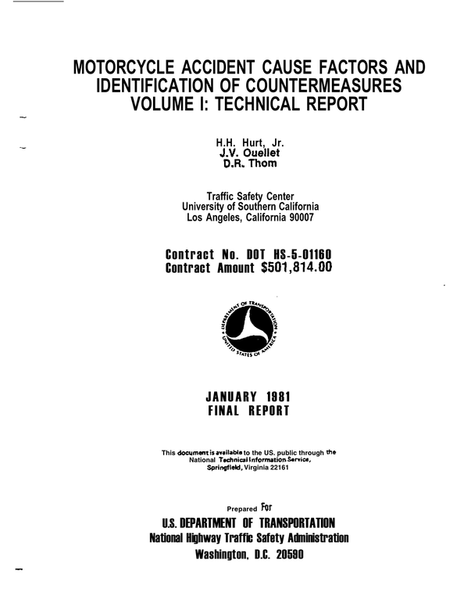
Title page
More or less similar to cover page.
Contains
Title of the Proposal
Name of the writer
Name of the person or organization to which the report is being submitted/approving authority
Date

Slide 20
Certificate
They vouch for the original
contribution of the thesis writer.

Slide 21
Acknowledgements
Most thesis authors put in a page of thanks to those who have helped them in scientific matters, and also indirectly by providing such essentials as food, educational resources, genes, money, help, advice, friendship etc. If any of your work is collaborative, you should make it quite clear who did which sections

Slide 22
Table of Content
You should list all the main sections of the report in sequence with the page numbers they begin on.
If there are maps, charts, diagrams ,graphs, drawings included in your report, these should be listed separately under a title such as ‘List of Illustrations’ together with the page numbers on which they appear.
They are grouped under the heading ‘Figures’

Slide 23
Abstract
Of all your thesis, this part will be the most widely published and most read because it will be published in thesis abstracts. It is best written towards the end, but not at the very last minute because you will probably need several drafts. It should be a distillation of the thesis: a concise description of the problem(s) addressed, your method of solving it/them, your results and conclusions. An abstract must be self-contained. Usually it does not contain references. When a reference is necessary, the relevant details should be included in the text of the abstract. Check the word limit.

Slide 24
Introduction
What is the topic and why is it important? State the problem(s) as simply as you can. Remember that you have been working on this project for a few years, so you will be very close to it. Try to step back mentally and take a broader view of the problem. How does it fit into the broader world of your discipline?
The introduction should be interesting. If you bore the reader here, then you are unlikely to revive his/her interest in the Materials and Methods section. Go to the library and read several thesis introductions. This section might go through several drafts to make it read well and logical, while keeping it short. For this section, it is a good idea to ask someone who is not a specialist to read it and to comment. Is it an adequate introduction? Is it easy to follow? There is an argument for writing this section—or at least making a major revision of it—towards the end of the thesis writing. Your introduction should tell where the thesis is going, and this may become clearer during the writing.

Slide 25
Literature Review
Where did the problem come from? What is already known about this problem? What other methods have been tried to solve it? Ideally, you will already have much of the hard work done, if you have been keeping up with the literature as you vowed to do at the beginning of your study, and if you have made notes about important papers over the years. If you have summarized those papers, then you have some good starting points for the review.
How many papers? How relevant do they have to be before you include them? Well, that is a matter of judgement. About a hundred is reasonable, but it will depend on the field. You are the world expert on the (narrow) topic of your thesis: you must demonstrate this.

Slide 26
Materials and Methods
This varies enormously from thesis to thesis and may be absent in theoretical theses. It should be possible for a competent researcher to reproduce exactly what you have done by following your description. There is a good chance that this test will be applied: sometimes after you have left, another researcher will want to do a similar experiment either with your gear, or on a new set-up in a foreign country.
Please write for the benefit of that researcher. In some theses, particularly multi-disciplinary or developmental ones, there may be more than one such chapter. In this case, the different disciplines should be indicated in the chapter titles.

Slide 27
Theory
If your thesis belongs to science category, you should include one chapter for discussing the basic theory on which your thesis is built. Of course this chapter is not exclusive for science subjects alone. For example when you write a thesis on any management topic, you can as well include this section explaining the basic concepts and theories involved in your detailed research

Slide 28
Results and Discussion
The division of Results and Discussion material into chapters is usually best done according to subject matter. Make sure that you have described the conditions which obtained each set of results. What was held constant? What were the other relevant parameters? Also make sure that you have used appropriate statistical analyses. Where applicable, show measurement errors and standard errors on the graphs. Use appropriate statistical tests. In most cases, your results need discussion. What do they mean? How do they fit into the existing body of knowledge? Are they consistent with current theories? Do they give new insights? Do they suggest new theories or mechanisms?

Slide 29
Conclusion
Purpose: States briefly the major inferences that can be drawn from the discussion.
Content:
must be based on information presented in the discussion.
each conclusion should be presented as a separate paragraph,
with paragraphs numbered in sequence for easy reference
never suggest or recommend future action.

Slide 30
Recommendations
Purpose: Suggests a course of action based on the findings and conclusions.
Content:
must follow logically from the conclusions
must be supported both by the conclusions and by the data in the discussion

Slide 31
Reference/Bibliography
Purpose: Acknowledge use of materials from printed sources in the preparation of your report. Indicate exact source of all quotations and/or results of previous work.
Content: Author's name, title of book, year published, publisher's name, city, ISBN number, page number.
Bibliographic entries are listed alphabetically by the name of the author or by the first major work of the title.
Example: Vetterli, C. “Technical Report Guidelines”, Internship Journal, Vol. 1 No. 1,August 1992.
Common knowledge does not require a reference, e.g. the speed of light the atomic weight of some element. If a new value for a commonly accepted quantity is cited, the source should be referenced.

Slide 32


Slide 33
Appendices
If there is material that should be in the thesis but which would break up the flow or bore the reader unbearably, include it as an appendix. Some things which are typically included in appendices are: important and original computer programs, data files that are too large to be represented simply in the results chapters, and pictures or diagrams of results which are not important enough to keep in the main text.

